Slide 1
NoSQL DATABASE MANAGEMENT

Slide 2
Unit-1 Structured Query Language-I

Slide 3
DATABASE: The collection of related data from which users can efficiently retrieve the desired information.
DBMS: It is an integrated set of programs used to create and maintain a database .The main objective of a DBMS is to provide a convenient and effective method of defining,storing,retreiving and manipulating the data contained in the data base.
ADVANTAGES:
The main advantage of DBMS is centralized data management where the data are stored at a centralized location and are shared among multiple users.
Controlled data redundancy: All the files are integrated, and each logical data item is stored at a central location. This eliminates replicating the data item and ensures consistency.
Enforcing data integrity: Easier. Various integrity constraints are identified by the designer during the database design.
Data sharing:The data stored in the database can be shared among multiple users or application programs.
Ease of application development: The application programmer develops the application programs according to the needs of the users

Slide 4
Data security: The DBMS ensures the means of access to the database is through an authorized channel.
Multiple user interfaces: DBMS provides different types of interfaces such as query languages, Program interfaces and graphical user interfaces that include form-style and menu-driven interfaces
Backup and recovery: Recovery from hardware and software failures
Program-data independence:The independence between the programs and the data.# Changing the structure of the database without making any changes in application programs
Data abstraction: Database system provide an abstract view of the data to its users without giving the physical storage and implementation details.
Supports multiple views of the data: A database can be accessed by many users and each of them have a different perspective or view of the data.

Slide 5
Purpose of Database System
In the early days, database applications were built on top of file systems
Drawbacks of using file systems to store data:
1.Data redundancy and in consistency: Multiple file formats, duplication of information in different files
2.Difficulty in accessing data :Need to write a new program to carry out each new task
3.Data isolation : multiple files and formats
4.Integrity problems: The data values stored in the database satisfy certain conditions. Integrity constraints (e.g. account balance > 0) become part of program code

Slide 6
5.Atomicity of updates: Failures may leave database in an inconsistent state with partial updates carried out.
E.g. transfer of funds from one account to another should either complete or not happen at all
6. Concurrent access Anomalies: Multiple users update the data simultaneously and uncontrolled concurrent accesses can lead to inconsistencies
E.g. two people reading a balance and updating it at the same time
7.Security problems: Prevention of data access by unauthorized users
Database systems offer solutions to all the above problems

Slide 7
Data Models
A collection of tools for describing data, data relationships, data semantics ,data constraints
Entity-Relationship model
Relational model
Other models:
Object-oriented model
Object relational data model
Semi-structured data models
Older models:
network model and hierarchical model

Slide 8
Entity-Relationship Model
Entity Sets
Relationship Sets
Design Issues
Mapping Constraints
Keys
E-R Diagram
Extended E-R Features
Design of an E-R Database Schema
Reduction of an E-R Schema to Tables

Slide 9
Entity Sets
A database can be modeled as:
a collection of entities,
relationship among entities.
An entity is an object that exists and is distinguishable from other objects.
Example: specific person, company, event, plant
Entities have attributes
Example: people have names and addresses
An entity set is a set of entities of the same type that share the same properties.
Example: set of all persons, companies, trees, holidays

Slide 10
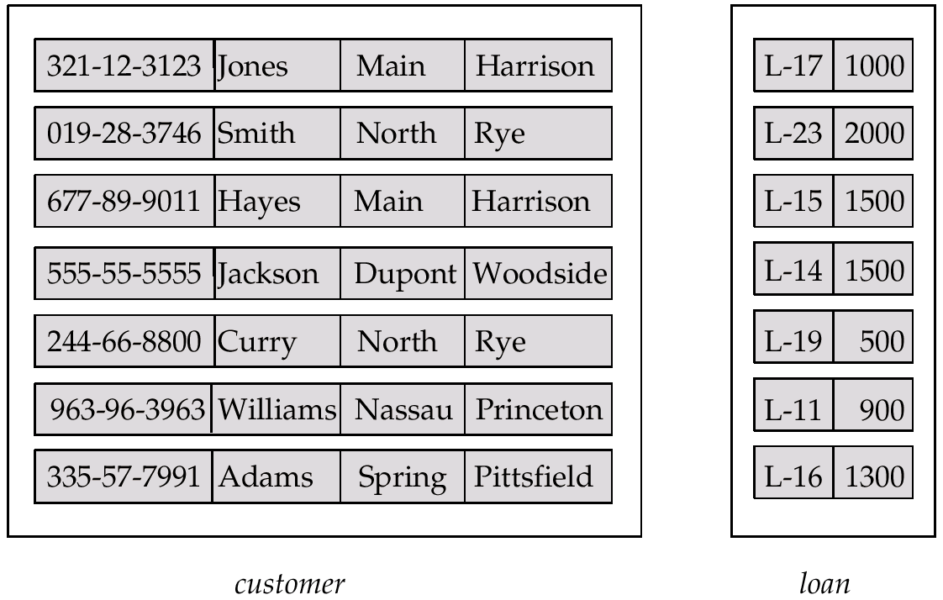
Entity Sets customer and loan
customer-id customer- customer- customer- loan- amount name street city number

Slide 11
Attributes
An entity is represented by a set of attributes, that is descriptive properties possessed by all members of an entity set.
Domain – the set of permitted values for each attribute
Attribute types:
Simple and composite attributes.
Single-valued and multi-valued attributes
E.g. multivalued attribute: phone-numbers
Derived attributes
Can be computed from other attributes
E.g. age, given date of birth
Example:
customer = (customer-id, customer-name, customer-street, customer-city) loan = (loan-number, amount)

Slide 12
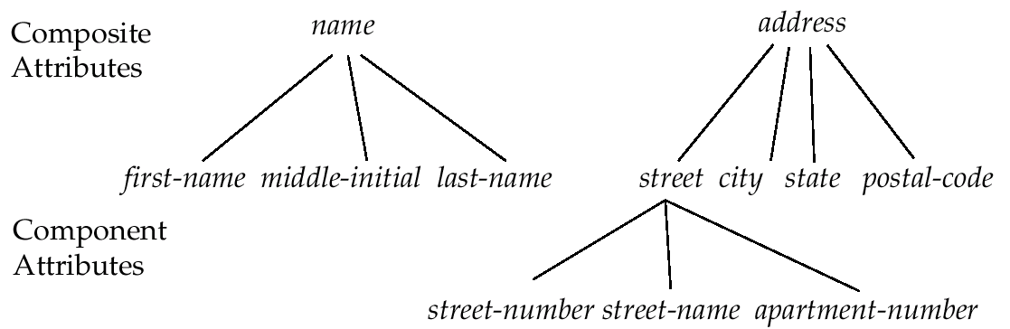
Composite Attributes

Slide 13
Relationship Sets
A relationship is an association among several entities
Example: Hayes depositor A-102 customer entity relationship set account entity
A relationship set is a mathematical relation among n ≥ 2 entities, each taken from entity sets
{(e₁, e₂, … e_{n}) | e₁ ∈ E₁, e₂ ∈ E₂, …, e_{n} ∈ E_{n}} where (e₁, e₂, …, e_{n}) is a relationship
Example:
(Hayes, A-102) ∈ depositor

Slide 14
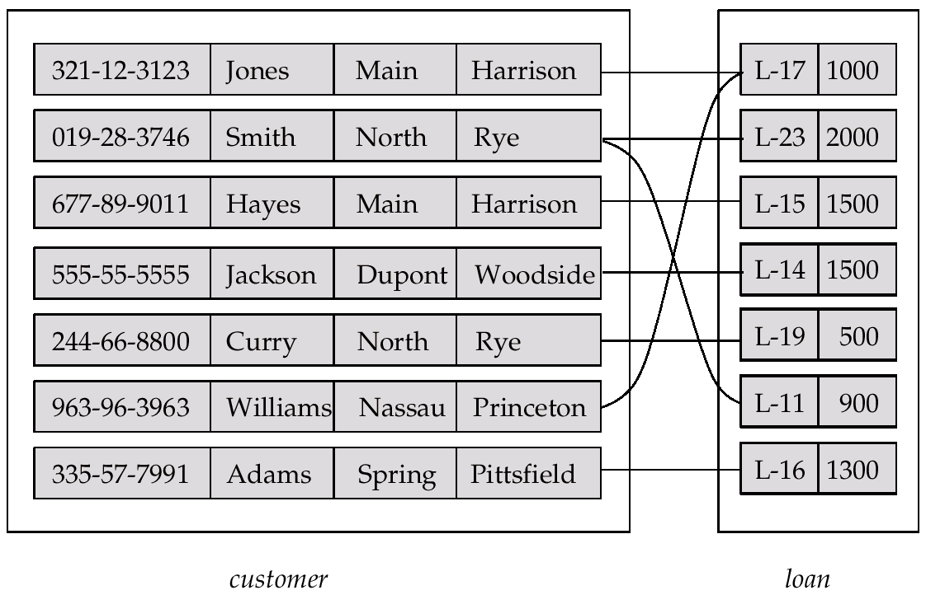
Relationship Set borrower

Slide 15
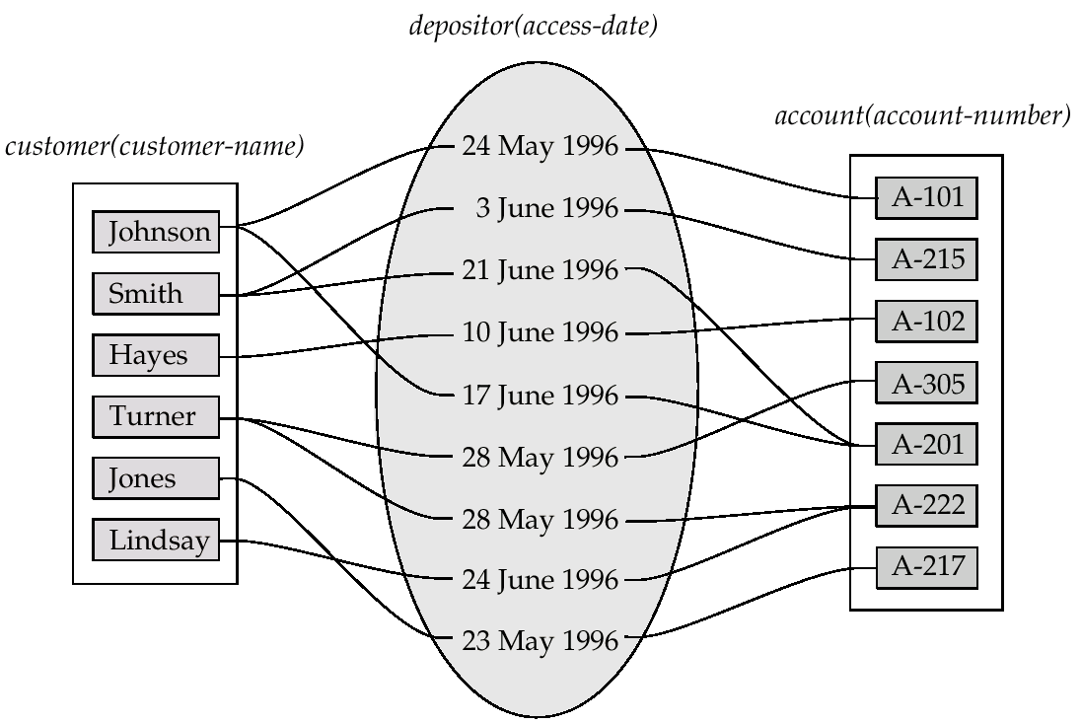
Relationship Sets (Cont.)
An attribute can also be property of a relationship set.
For instance, the depositor relationship set between entity sets customer and account may have the attribute access-date

Slide 16
Degree of a Relationship Set
Refers to number of entity sets that participate in a relationship set.
Relationship sets that involve two entity sets are binary (or degree two). Generally, most relationship sets in a database system are binary.
Relationship sets may involve more than two entity sets.
Relationships between more than two entity sets are rare. Most relationships are binary. (More on this later.)
E.g. Suppose employees of a bank may have jobs (responsibilities) at multiple branches, with different jobs at different branches. Then there is a ternary relationship set between entity sets employee, job and branch

Slide 17
Mapping Cardinalities
Express the number of entities to which another entity can be associated via a relationship set.
Most useful in describing binary relationship sets.
For a binary relationship set the mapping cardinality must be one of the following types:
One to one
One to many
Many to one
Many to many

Slide 18
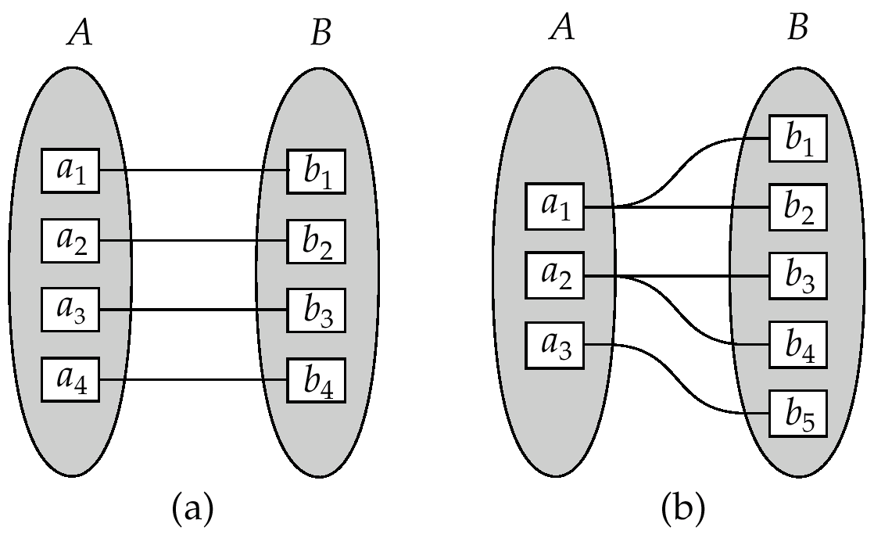
Mapping Cardinalities
One to one
One to many
Note: Some elements in A and B may not be mapped to any
elements in the other set

Slide 19
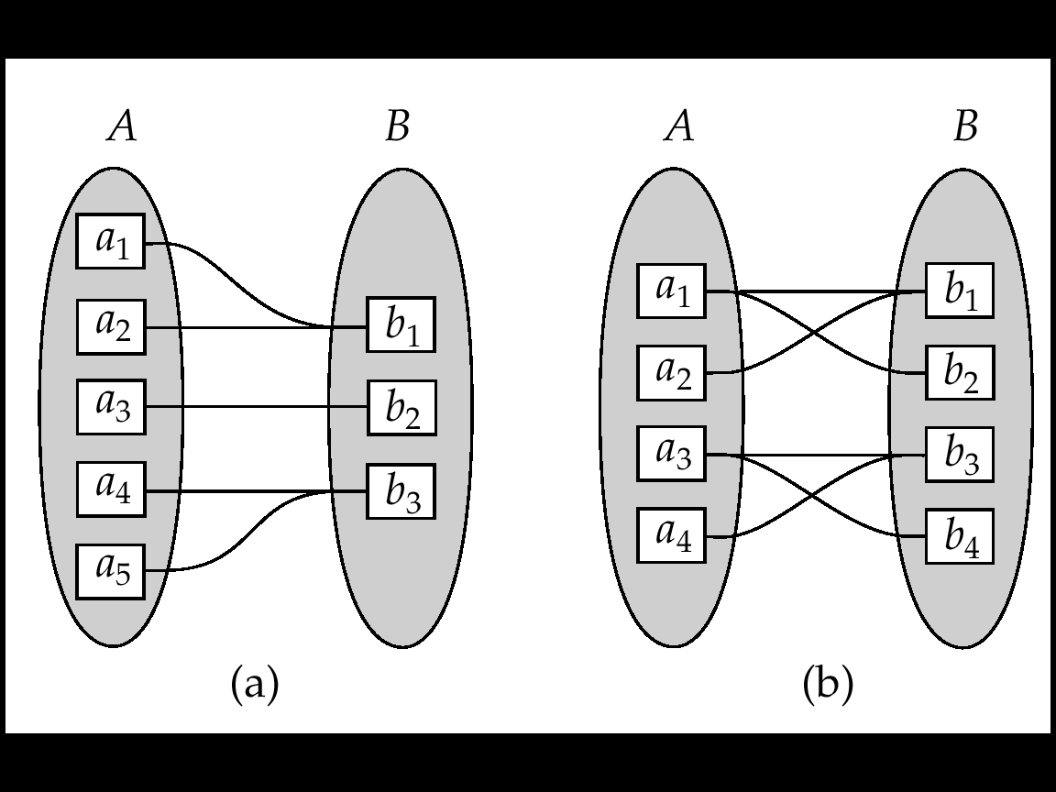
Mapping Cardinalities
Many to one
Many to many
Note: Some elements in A and B may not be mapped to any
elements in the other set

Slide 20
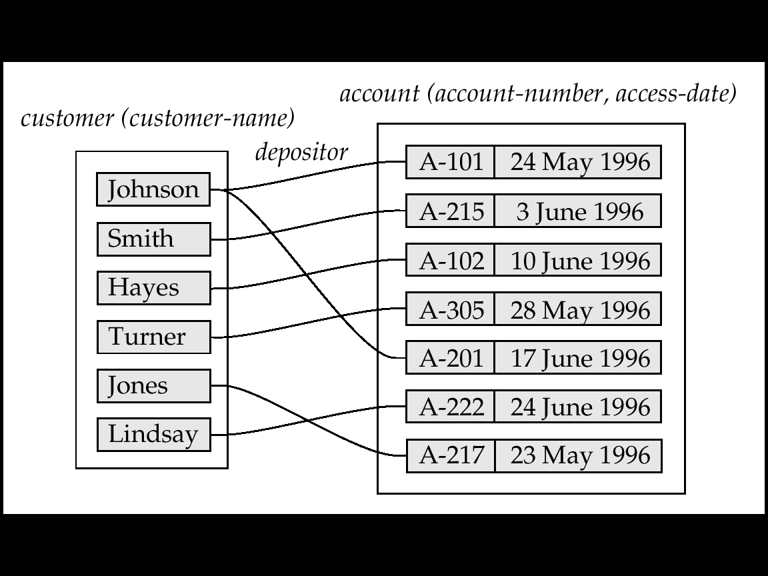
Mapping Cardinalities affect ER Design
Can make access-date an attribute of account, instead of a relationship attribute, if each account can have only one customer
I.e., the relationship from account to customer is many to one, or equivalently, customer to account is one to many

Slide 21
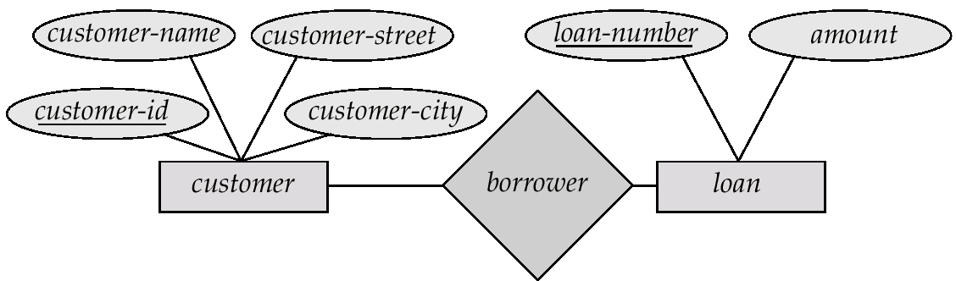
E-R Diagrams
Rectangles represent entity sets.
Diamonds represent relationship sets.
Lines link attributes to entity sets and entity sets to relationship sets.
Ellipses represent attributes
Double ellipses represent multivalued attributes.
Dashed ellipses denote derived attributes.
Underline indicates primary key attributes (will study later)

Slide 22
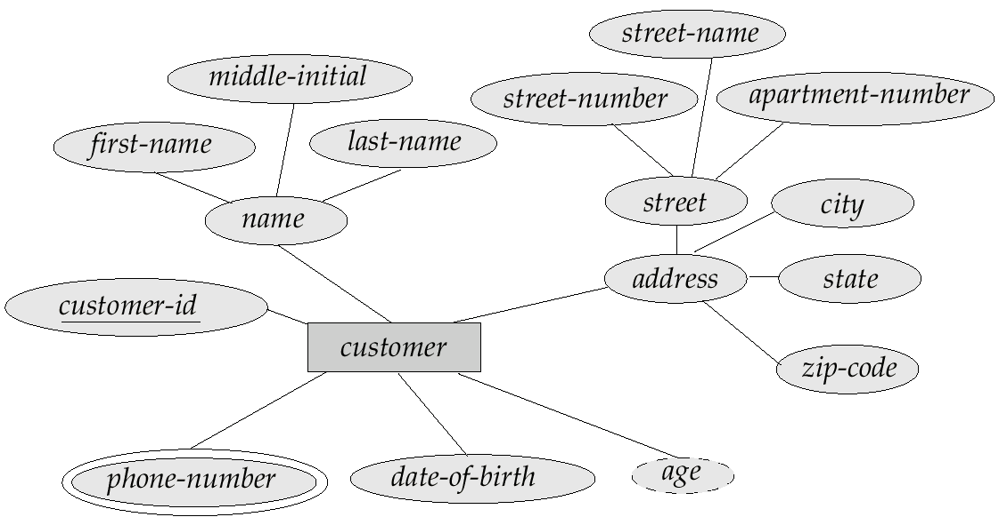
E-R Diagram With Composite, Multivalued, and Derived Attributes

Slide 23
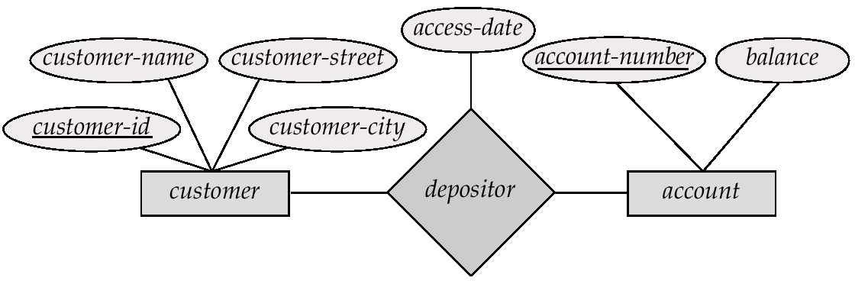
Relationship Sets with Attributes

Slide 24
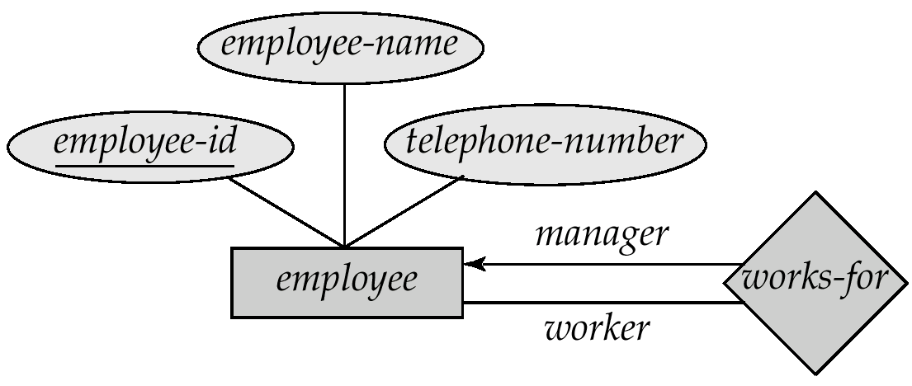
Roles
Entity sets of a relationship need not be distinct
The labels “manager” and “worker” are called roles; they specify how employee entities interact via the works-for relationship set.
Roles are indicated in E-R diagrams by labeling the lines that connect diamonds to rectangles.
Role labels are optional, and are used to clarify semantics of the relationship

Slide 25
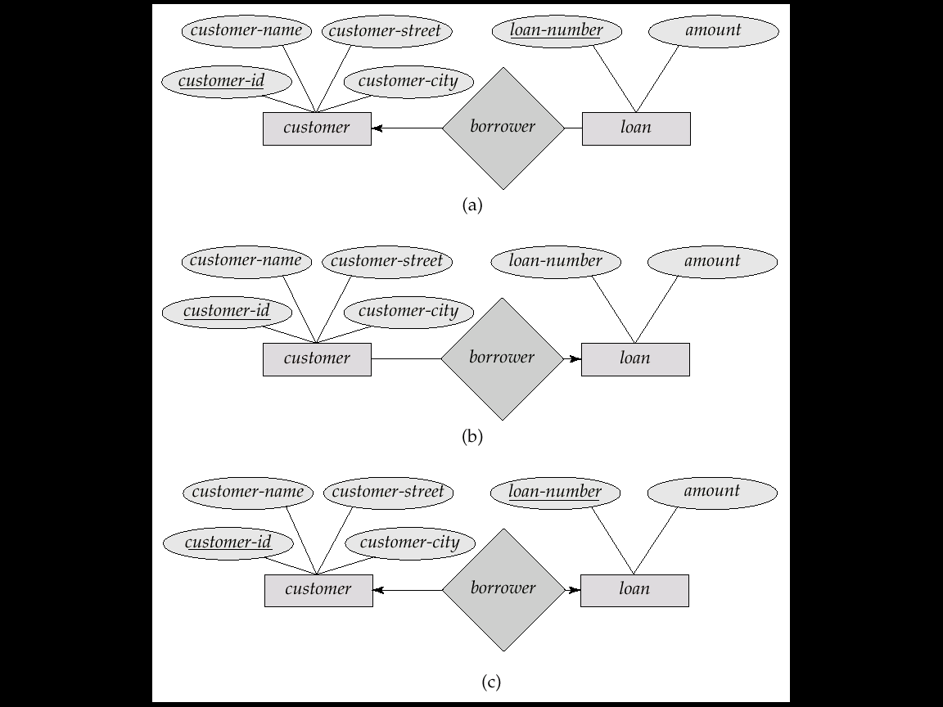
Cardinality Constraints
We express cardinality constraints by drawing either a directed line (→), signifying “one,” or an undirected line (—), signifying “many,” between the relationship set and the entity set.
E.g.: One-to-one relationship:
A customer is associated with at most one loan via the relationship borrower
A loan is associated with at most one customer via borrower

Slide 26
One-To-Many Relationship
In the one-to-many relationship a loan is associated with at most one customer via borrower, a customer is associated with several (including 0) loans via borrower

Slide 27
Many-To-One Relationships
In a many-to-one relationship a loan is associated with several (including 0) customers via borrower, a customer is associated with at most one loan via borrower

Slide 28
Many-To-Many Relationship
A customer is associated with several (possibly 0) loans via borrower
A loan is associated with several (possibly 0) customers via borrower

Slide 29
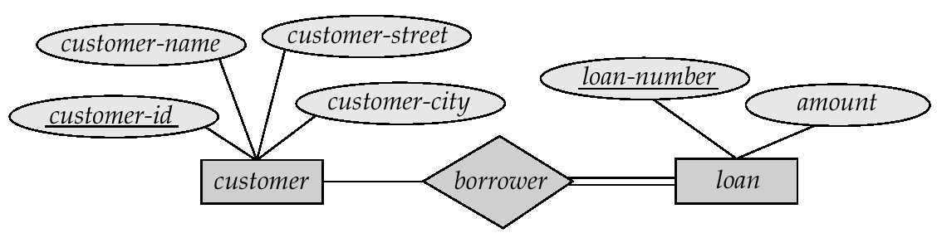
Participation of an Entity Set in a Relationship Set
Total participation (indicated by double line): every entity in the entity set participates in at least one relationship in the relationship set
E.g. participation of loan in borrower is total
every loan must have a customer associated to it via borrower
Partial participation: some entities may not participate in any relationship in the relationship set
E.g. participation of customer in borrower is partial

Slide 30
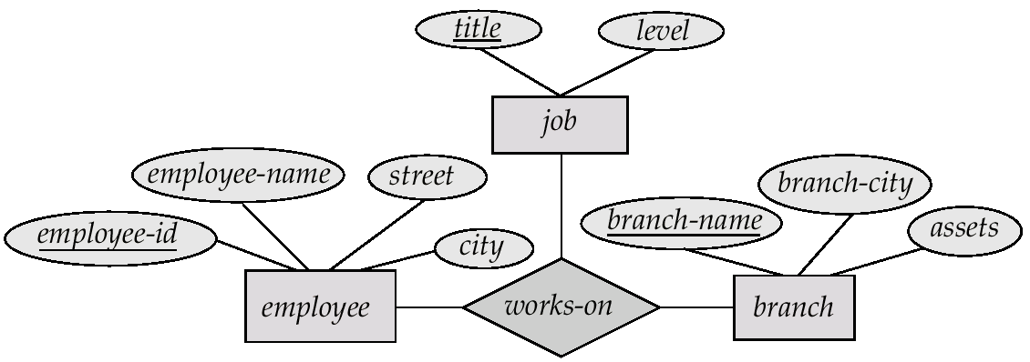
E-R Diagram with a Ternary Relationship

Slide 31
Weak Entity Sets
An entity set that does not have a primary key is referred to as a weak entity set.
The primary key of a weak entity set is formed by the primary key of the strong entity set on which the weak entity set is existence dependent, plus the weak entity set’s discriminator.

Slide 32
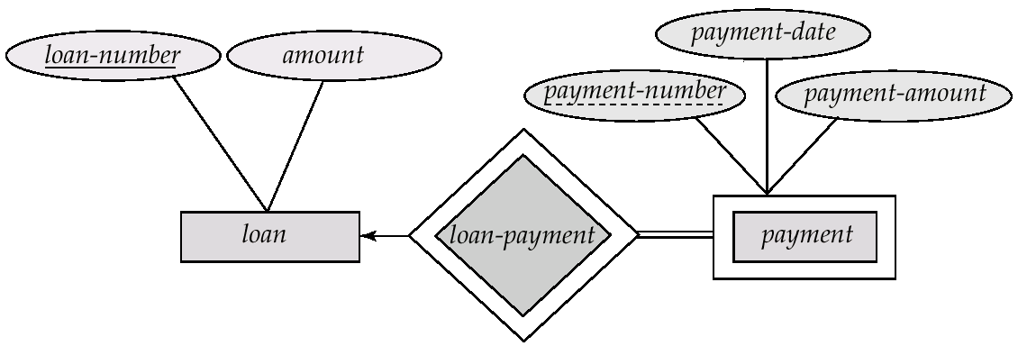
Weak Entity Sets
We depict a weak entity set by double rectangles.
We underline the discriminator of a weak entity set with a dashed line.
payment-number – discriminator of the payment entity set
Primary key for payment – (loan-number, payment-number)

Slide 33
Weak Entity Sets (Cont.)
Note: the primary key of the strong entity set is not explicitly stored with the weak entity set, since it is implicit in the identifying relationship.
If loan-number were explicitly stored, payment could be made a strong entity, but then the relationship between payment and loan would be duplicated by an implicit relationship defined by the attribute loan-number common to payment and loan

Slide 34
Specialization
Top-down design process; we designate subgroupings within an entity set that are distinctive from other entities in the set.
These subgroupings become lower-level entity sets that have attributes or participate in relationships that do not apply to the higher-level entity set.
Depicted by a triangle component labeled ISA (E.g. customer “is a” person).
Attribute inheritance – a lower-level entity set inherits all the attributes and relationship participation of the higher-level entity set to which it is linked.

Slide 35
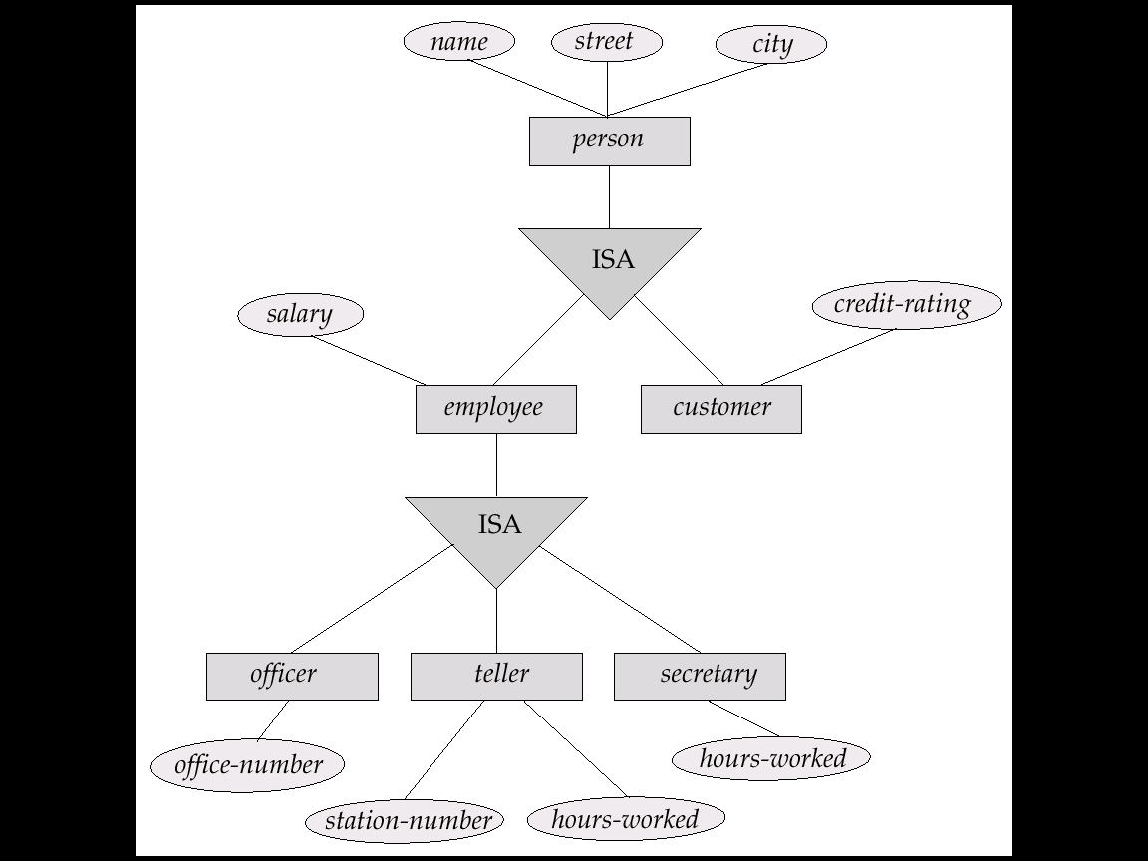
Specialization Example

Slide 36
Generalization
A bottom-up design process – combine a number of entity sets that share the same features into a higher-level entity set.
Specialization and generalization are simple inversions of each other; they are represented in an E-R diagram in the same way.
The terms specialization and generalization are used interchangeably.

Slide 37
Specialization and Generalization (Contd.)
Can have multiple specializations of an entity set based on different features.
E.g. permanent-employee vs. temporary-employee, in addition to officer vs. secretary vs. teller
Each particular employee would be
a member of one of permanent-employee or temporary-employee,
and also a member of one of officer, secretary, or teller
The ISA relationship also referred to as superclass - subclass relationship

Slide 38
Design Constraints on a Specialization/Generalization
Constraint on which entities can be members of a given lower-level entity set.
condition-defined
E.g. all customers over 65 years are members of senior-citizen entity set; senior-citizen ISA person.
user-defined
Constraint on whether or not entities may belong to more than one lower-level entity set within a single generalization.
Disjoint
an entity can belong to only one lower-level entity set
Noted in E-R diagram by writing disjoint next to the ISA triangle
Overlapping
an entity can belong to more than one lower-level entity set

Slide 39
Design Constraints on a Specialization/Generalization (Contd.)
Completeness constraint -- specifies whether or not an entity in the higher-level entity set must belong to at least one of the lower-level entity sets within a generalization.
total : an entity must belong to one of the lower-level entity sets
partial: an entity need not belong to one of the lower-level entity sets

Slide 40
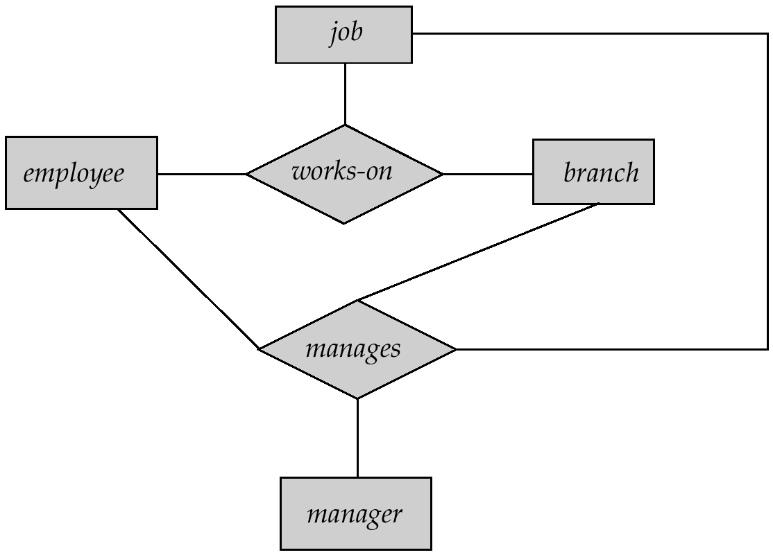
Aggregation
Consider the ternary relationship works-on, which we saw earlier
Suppose we want to record managers for tasks performed by an employee at a branch

Slide 41
Aggregation (Cont.)
Relationship sets works-on and manages represent overlapping information
Every manages relationship corresponds to a works-on relationship
However, some works-on relationships may not correspond to any manages relationships
So we can’t discard the works-on relationship
Eliminate this redundancy via aggregation
Treat relationship as an abstract entity
Allows relationships between relationships
Abstraction of relationship into new entity
Without introducing redundancy, the following diagram represents:
An employee works on a particular job at a particular branch
An employee, branch, job combination may have an associated manager

Slide 42
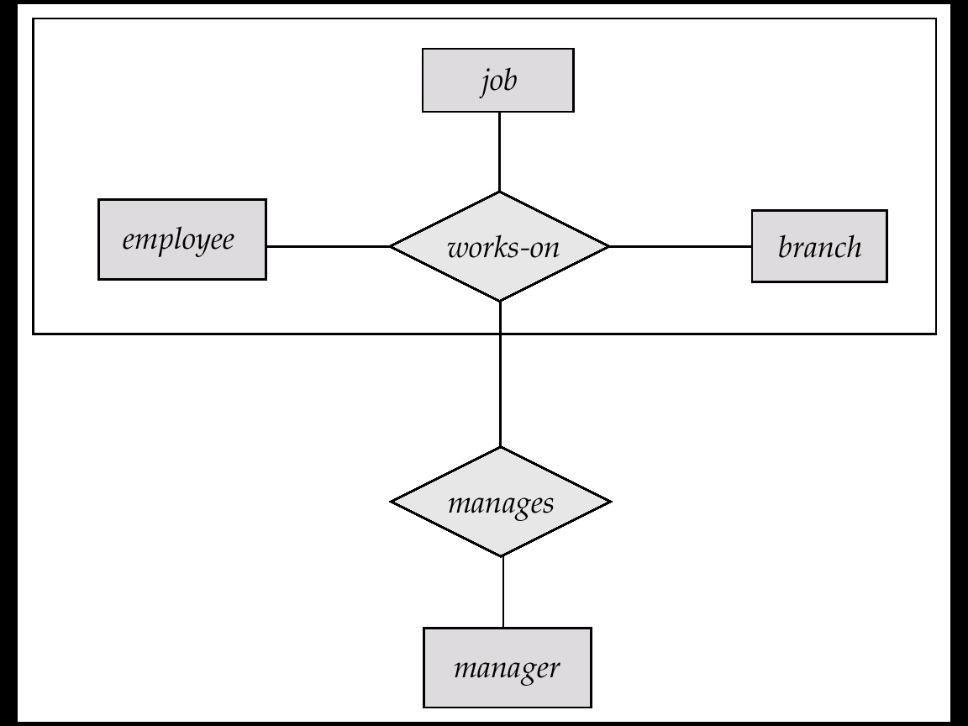
E-R Diagram With Aggregation

Slide 43
E-R Design Decisions
The use of an attribute or entity set to represent an object.
Whether a real-world concept is best expressed by an entity set or a relationship set.
The use of a ternary relationship versus a pair of binary relationships.
The use of a strong or weak entity set.
The use of specialization/generalization – contributes to modularity in the design.
The use of aggregation – can treat the aggregate entity set as a single unit without concern for the details of its internal structure.

Slide 44
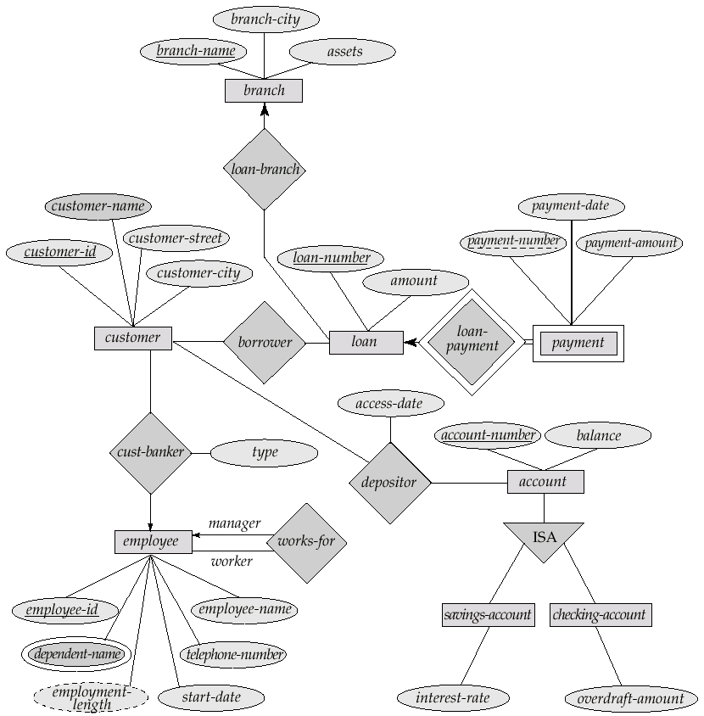
E-R Diagram for a Banking Enterprise

Slide 45
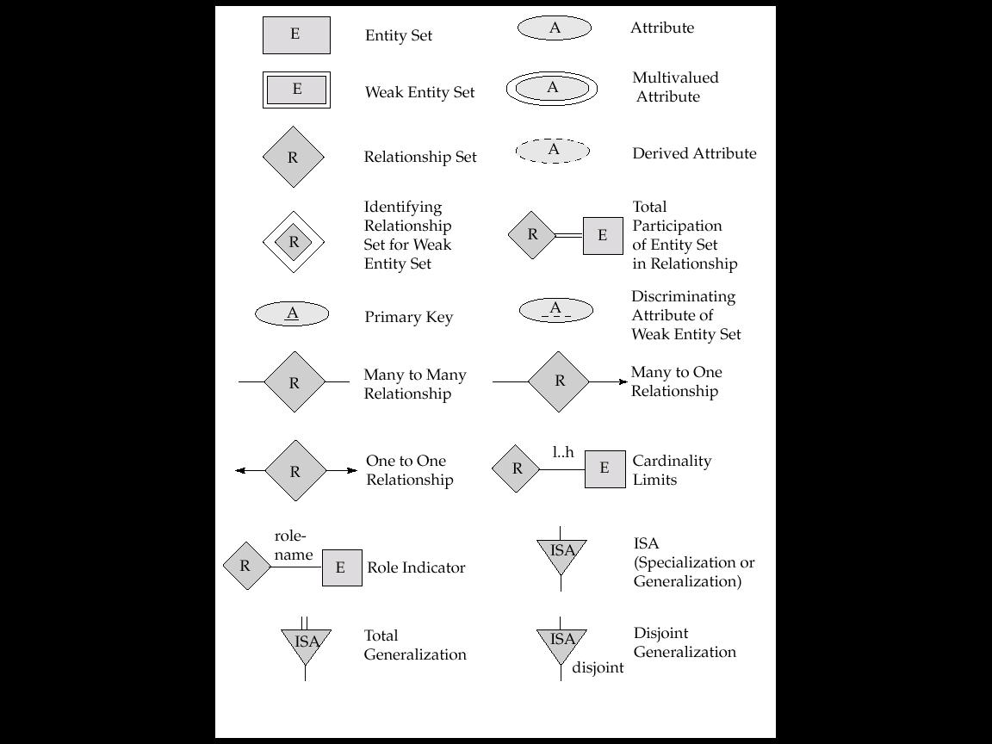
Summary of Symbols Used in E-R Notation

Slide 46
Summary of Symbols (Cont.)

Slide 47
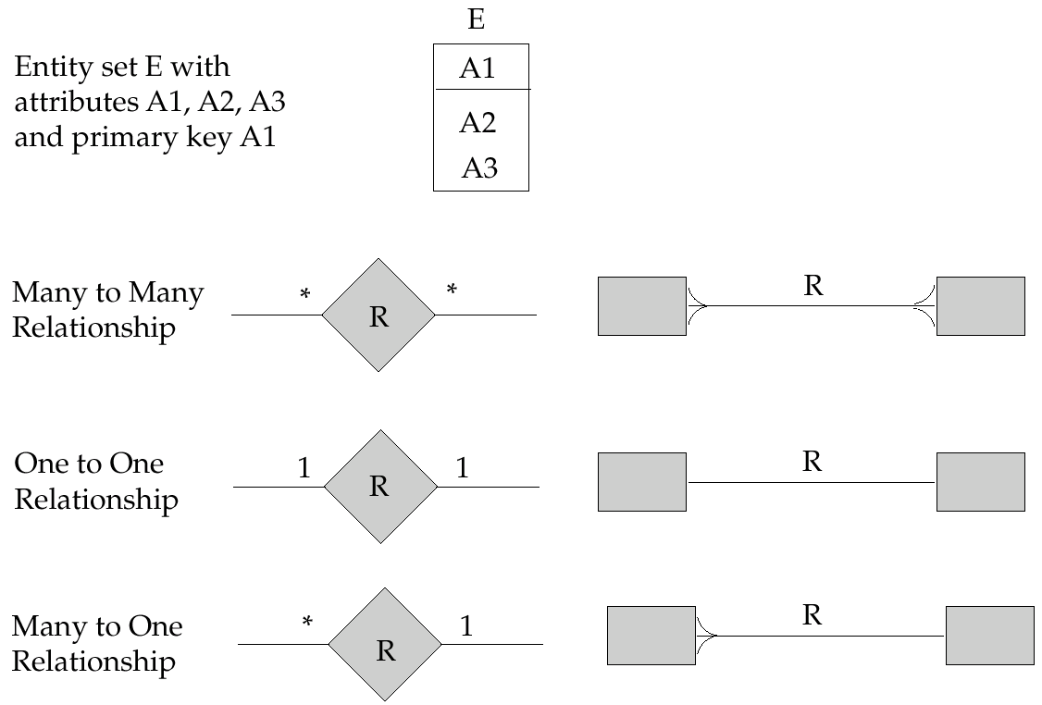
Alternative E-R Notations

